Slide 1
Metabolomics Core Working Group August Agenda
Time | Agenda Items | Lead
6:00 – 6:05 AM | Welcome and overview of meeting agenda | Elesha Kingshott
6:05 – 6:25 AM | Project charter: Goals of the Working Group Outputs Timelines Cadence of meetings Other logistics | Elesha Kingshott
6:25 – 6:50 AM | Update on data analysis Discussion on priorities and next steps | Nima Aghaeepour
6:50 – 7:00 AM | Agenda items for next meeting | All participants
7:00 AM | Close and adjourn | Elesha Kingshott

Slide 2
Project Charter
Key questions the group needs to answer
Goals of the Working Group
Finalize MOMI consortium-wide metabolomics work
Publish articles on pooled analyses
Are these the right goals? Are there other goals we should consider?
Outputs
A final list of top metabolites to prioritize for Sapient to do molecule identification work
A publication plan
Are these the right outputs? Are there additional outputs that this group should focus on?
Timelines
What is realistic and feasible for this group to develop a finalized list of top metabolites for Sapient?
Please note that Sapient’s contract goes until December 2024.
What is a realistic and feasible timeline for publications?
Cadence of meetings
What meeting cadence is necessary to meet to achieve the goals and outputs?
Other logistics
Are there other logistics that the group would like to discuss?

Slide 3
Updated Data Analysis from Stanford

Slide 4
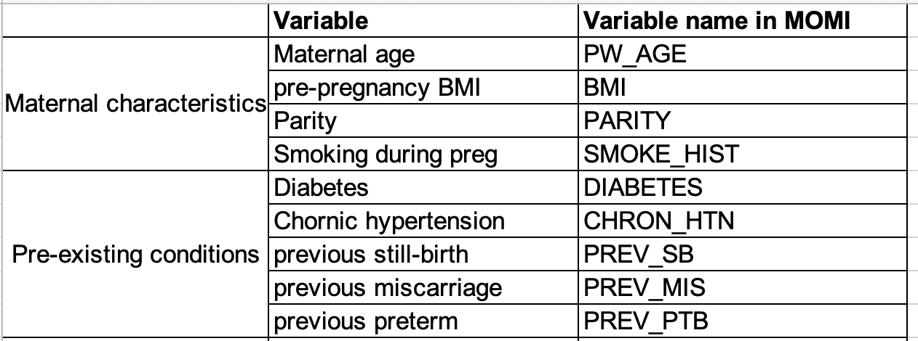
Added maternal phenotypic variables to the model
Preeclampsia

Slide 5
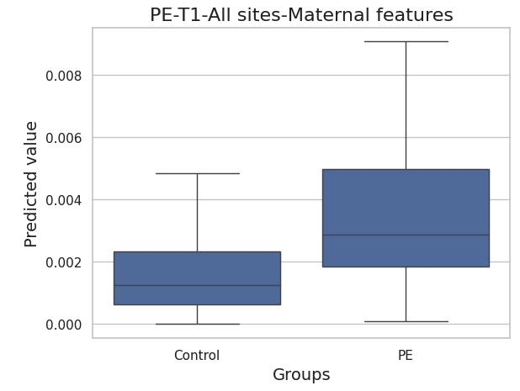
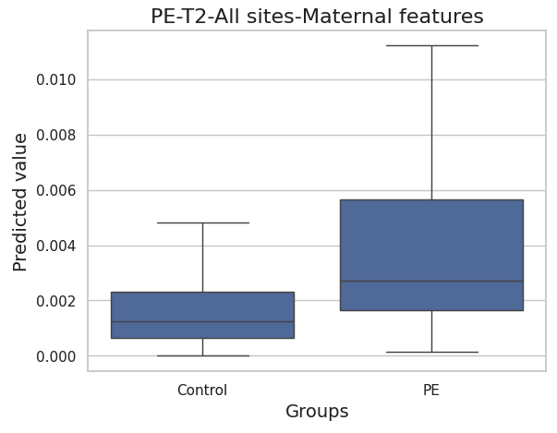
XGBoost model performance-all increased than before
AUROC=0.757 (metabolite only= 0.70)
AUPRC=0.061 (metabolite only= 0.03)
Prevalence=0.016
AUROC=0.752 (metabolite only= 0.72)
AUPRC=0.073 (metabolite only= 0.04)
Prevalence=0.017

Slide 6
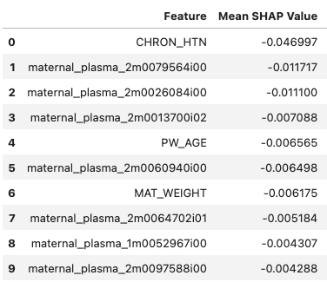
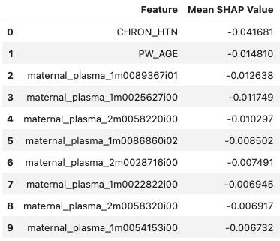
Feature importance
T1
T2

Slide 7
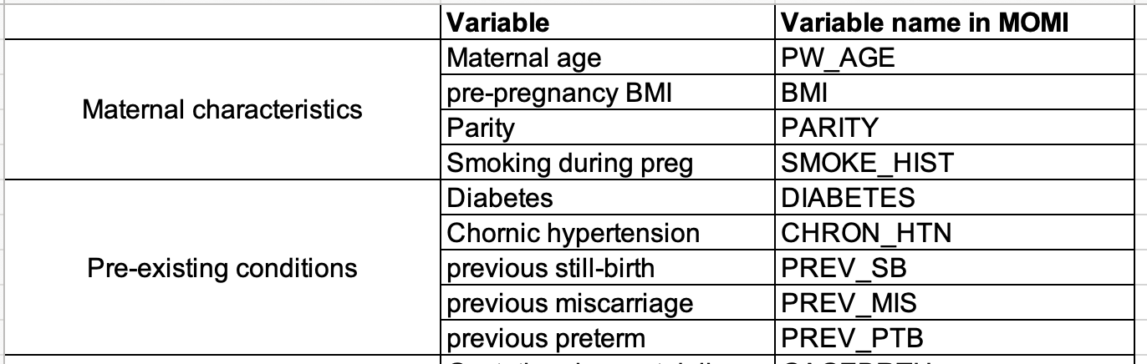
Stillbirth

Slide 8
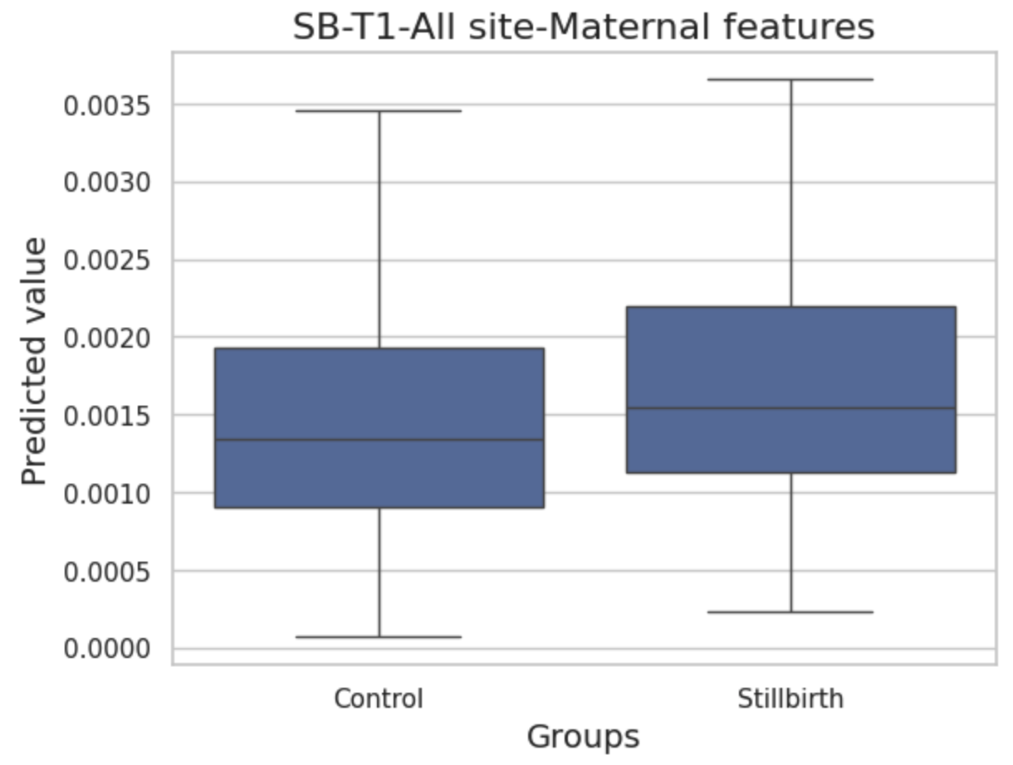
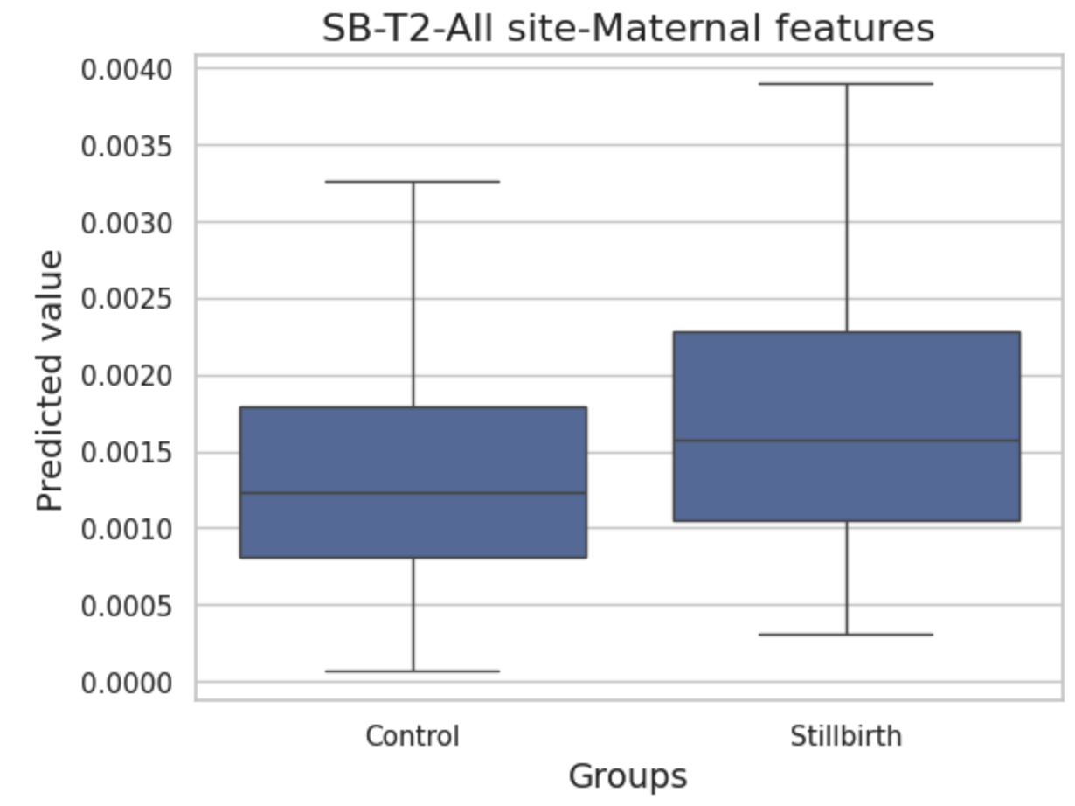
XGBoost model performance-didn’t change much
AUROC=0.583 (metabolite only=0.594)
AUPRC=0.033 (metabolite only=0.031)
Prevalence=0.014
AUROC=0.624 (metabolite only=0.621)
AUPRC=0.03 (metabolite only=0.029)
Prevalence=0.013

Slide 9
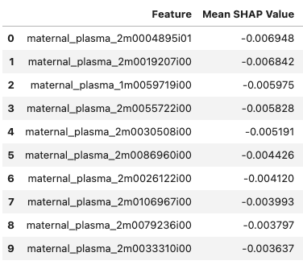
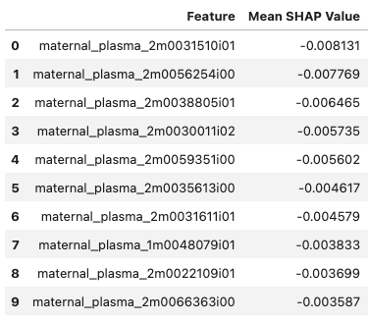
Feature importance
T1
T2

Slide 10
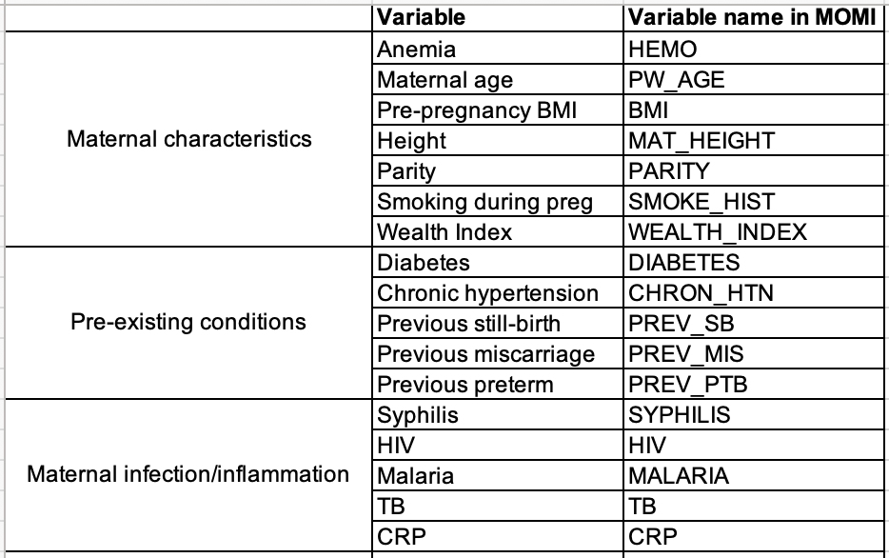
Preterm Birth

Slide 11
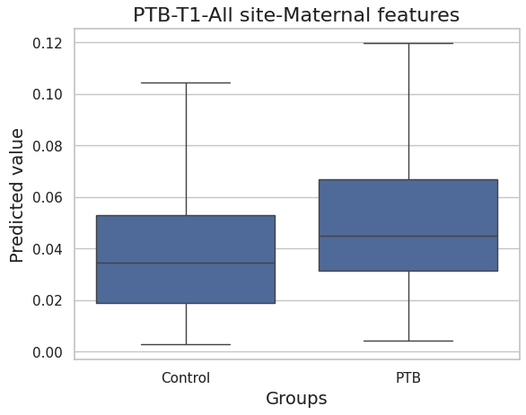
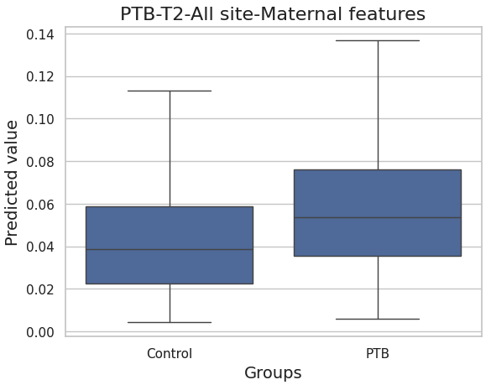
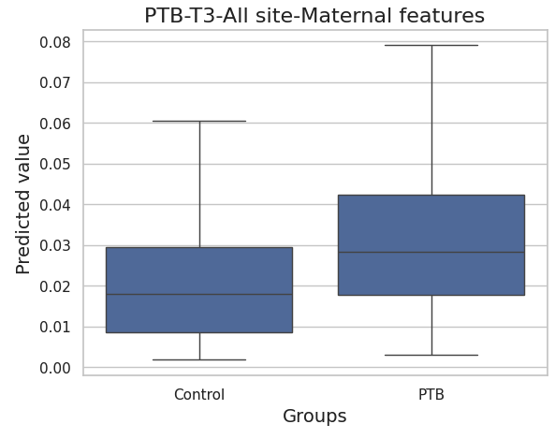
XGBoost model performance-all increased than before
AUROC=0.634(metabolite only=0.61)
AUPRC=0.163(metabolite only=0.156)
Prevalence=0.112
AUROC=0.651 (metabolite only=0.62)
AUPRC=0.167 (metabolite only=0.154)
Prevalence=0.097
AUROC=0.671 (metabolite only=0.662)
AUPRC=0.165 (metabolite only=0.161)
Prevalence=0.083

Slide 12
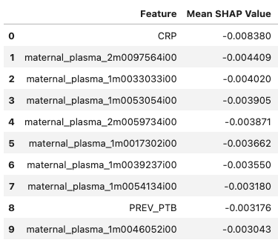
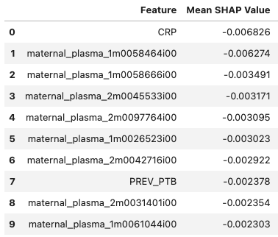
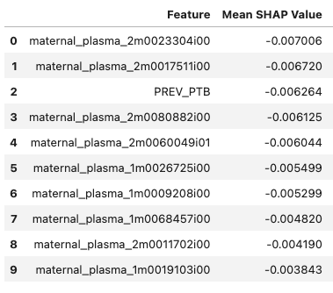
Feature importance
T1
T2
T3

Slide 13
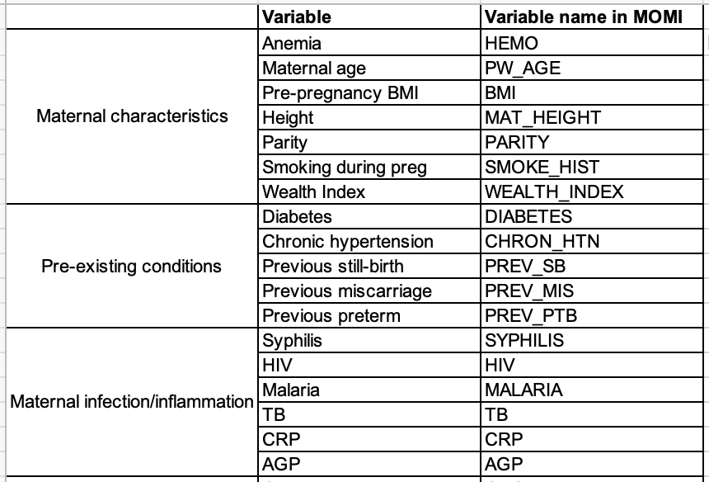
SGA

Slide 14
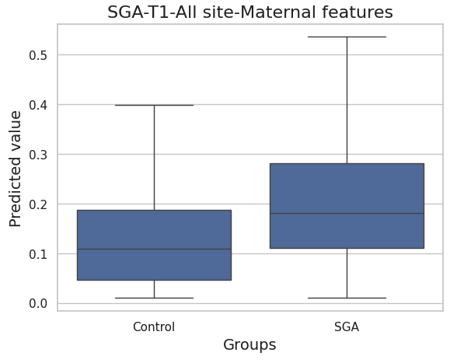
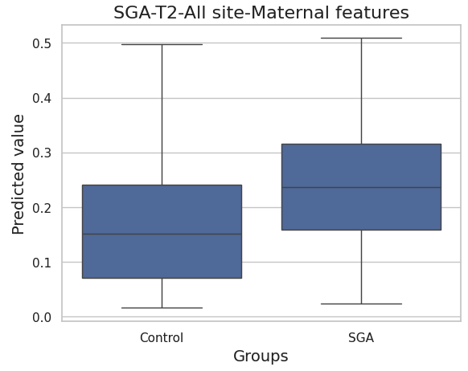
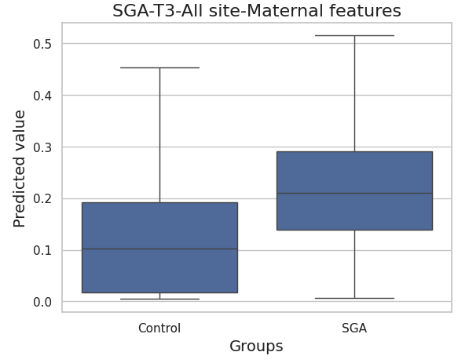
XGBoost model performance-all increased than before
AUROC=0.68(metabolite only=0.66)
AUPRC=0.352(metabolite only=0.325)
Prevalence=0.217
AUROC=0.682(metabolite only=0.67)
AUPRC=0.358(metabolite only=0.338)
Prevalence=0.227
AUROC=0.747(metabolite only=0.684)
AUPRC=0.395(metabolite only=0.344)
Prevalence=0.215

Slide 15
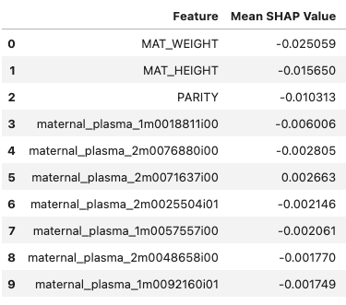
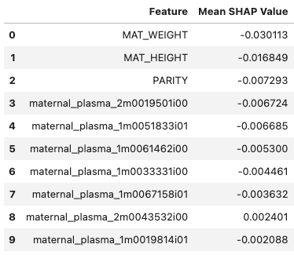
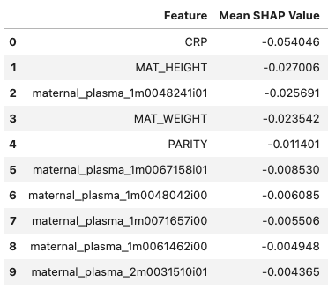
Feature importance
T1
T2
T3

Slide 16
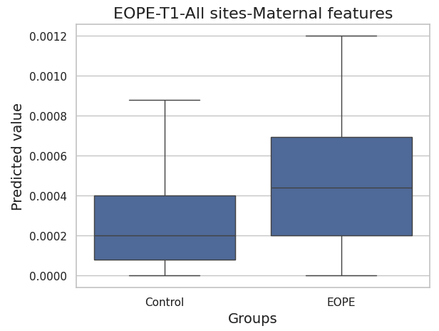
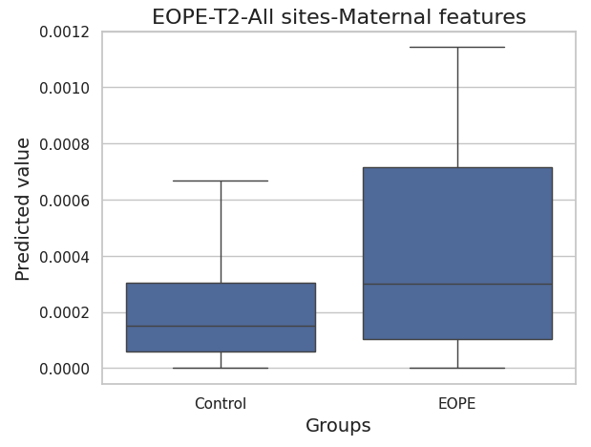
EOPE vs. Control
AUROC=0.685
AUPRC=0.009
Prevalence=0.004
AUROC=0.632
AUPRC=0.019
Prevalence=0.003

Slide 17
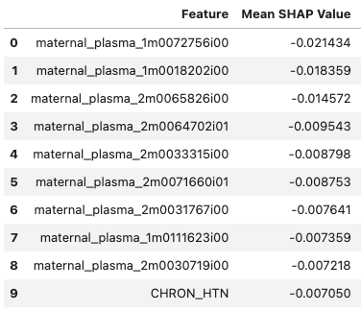
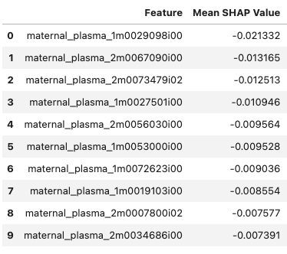
EOPE vs. Control feature importance
T1
T2

Slide 18
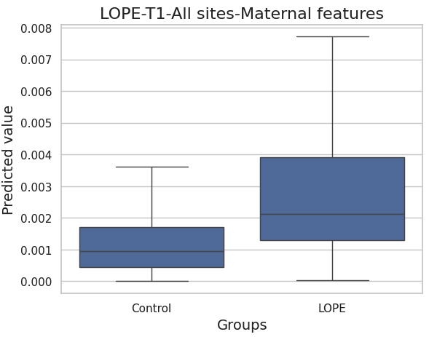
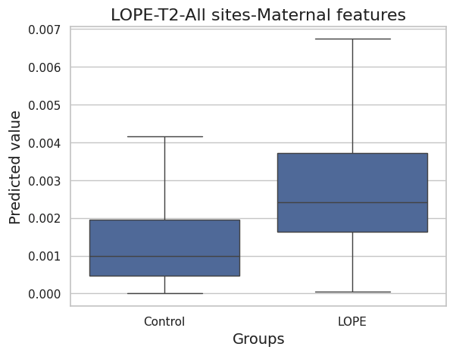
LOPE vs. Control
AUROC=0.758
AUPRC=0.05
Prevalence=0.013
AUROC=0.755
AUPRC=0.05
Prevalence=0.014

Slide 19
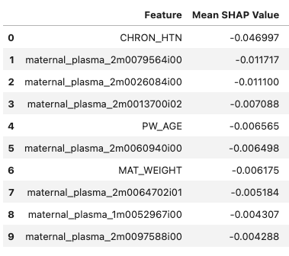
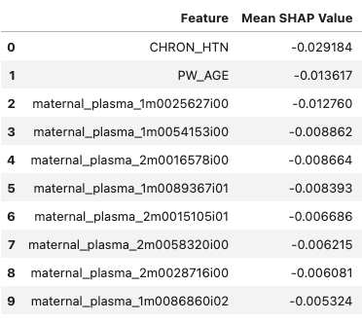
LOPE vs. Control feature importance
T1
T2

